Slide 1
June 2019
Hacking the Education Ecosystem

Slide 2
Every Child is born with enormous potential...
...the world is currently spending over $5 trillion on educating children to help them reach this potential

Slide 3
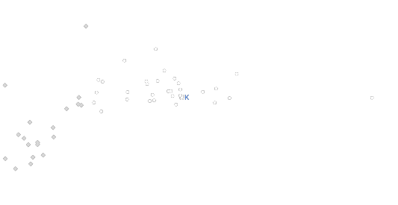
Yet, much of this money is wasted.
600
550
500
450
PISA Math Performance
400
350
300
0
60000
100000
150000
200000
Average spending per student from the age of 6 to 15 (USD, PPs)
Low spending
High spending
@wigdortz | @tineyco

Slide 4
Because there is no single solution
21st Century
Skills
School
Leadership
Parent
Engagement
Differentiated Learning
Traditional Skills
Health Care
Teacher Development
Curriculum
Early
Childhood
Technology
Social
Services
Economic Development
…to a problem so entrenched and complex.

Slide 5
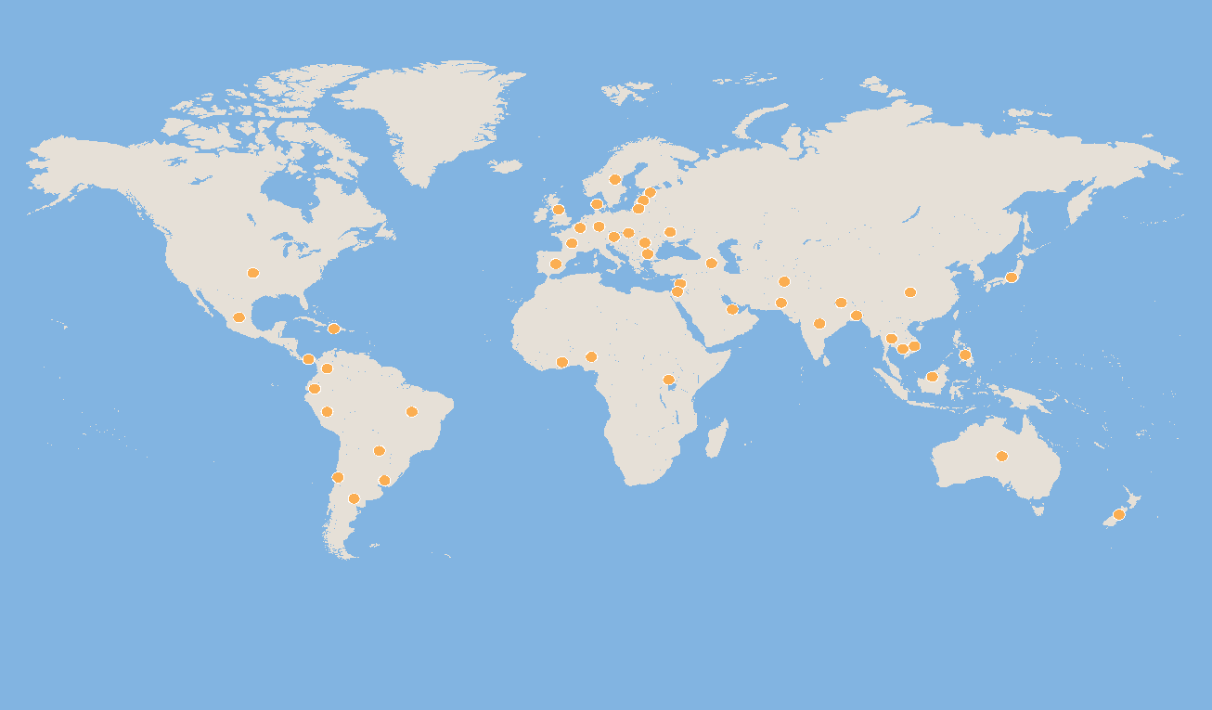
It’s all about unlocking leadership to hack the education system
We have first hand experience, we know our own supply pool will be more defensible and valuable, plus we’re uniquely positioned to do it.
I previously founded Teach First which became the UK’s largest graduate recruiter over 15 years.
We trained over 10,000 teachers and the model has now been taken to over 50 countries.
Notes:
While each local context is unique, similarities in the nature of the challenges facing children from place to place mean that solutions are often shareable. In tailoring the network’s approach to the needs of their local communities, Teach For All network partners develop new insights and better solutions. The global network enables partner staff, teachers, and alumni to share these innovations with colleagues around the world, and to learn from and adapt promising ideas in their own countries.
Teach For All’s global organization provides a platform that enables network partners to connect with and learn from each other, accelerating their individual and collective impact

Slide 6
People
Powered
Change.
Evidence.
48 Countries.
14,000 Teachers.
60,000 Alumni.
Short Term Impact:
External studies and internal student impact data demonstrate that network teachers are having a positive impact in the classroom.
Long term impact:
Over 65% of alumni across the network continue to work in education or with disadvantaged communities.
@wigdortz | @tineyco

Slide 7
Our mission at tiney is to unlock the potential of every child.
Our vision is to build the most trusted early years education brand in the world by creating 21st century childcare that works for educators, families and their children.

Slide 8
The problem
UK demand for home-based childcare is high, with an evergreen customer base
25%
11%
65%
Increase in home-based childcare demand between 2016-2018
Lower yearly costs (UK average 25hrs f/t)) versus equivalent Nursery Place.
of mothers of toddlers are now in full time or part-time work
But home-based independent childcare businesses do not currently work for providers
Decrease of existing supply
Lack of new entrants
Dejected workforce
50% of existing home-based businesses have closed in the last 10 yrs.
50% fewer home-based businesses are opening YoY (new registrations 18-19)
Those leaving cite isolation, billing complexity, admin time & Ofsted as main frictions

Slide 9
The opportunity
High quality early years care is a global issue with a sizeable home market to penetrate within the UK and a £50bn+ international market beyond that.
£5.5 billion
£50 billion+
Total size of UK childcare market (across all childcare provider types)
Total size of addressable international childcare market with 1% of OECD GDP spent on early years care
1 million
Estimated shortfall in childcare places currently on offer
Wider market
8%
By promoting our education ethos and building strong brand reputation we can position tiney for future revenue growth into the wider education category.
(Canada, EU, Australia = £16.5 billion, US = £40 billion)
Of the nursery market currently captured between two Nursery Chain supergroups with c.300 settings (2% of entire market)

Slide 10
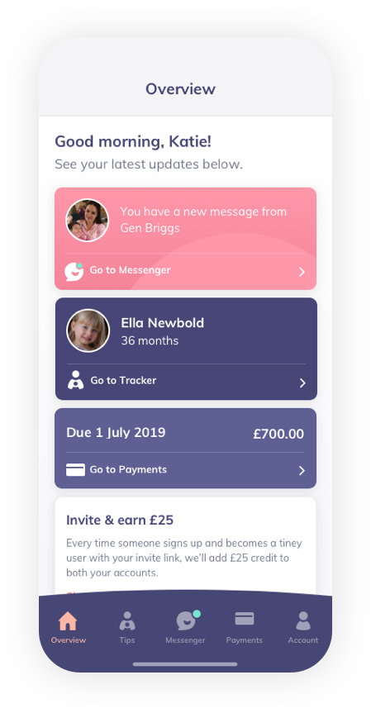
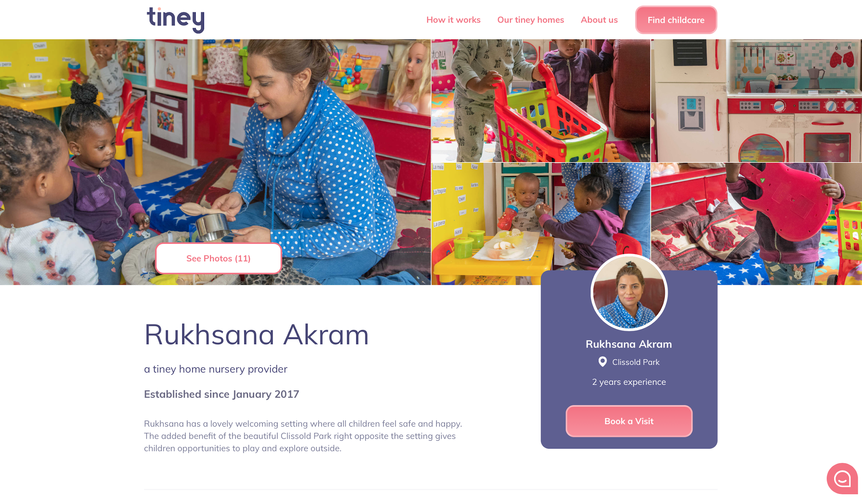
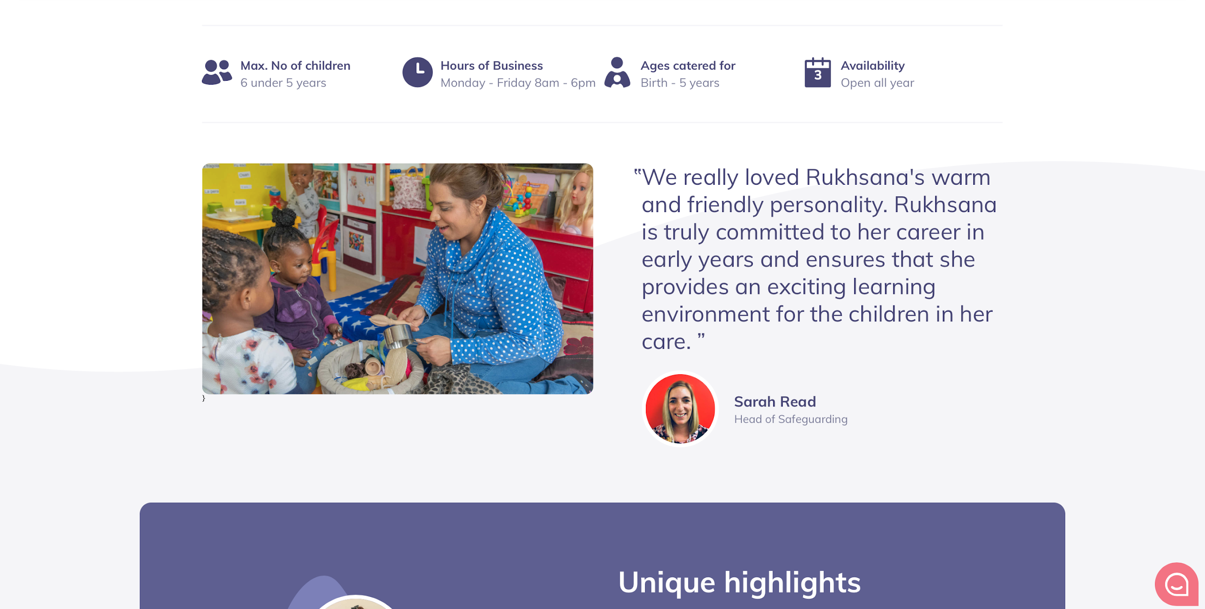
The Solution
Today, tiney is recruiting & training a new category of high quality childcare professionals using their own homes as childcare settings.
Through an online marketplace we enable families to find tiney homes in their local neighbourhood to get started quickly with long lasting care agreements.
We ensure the experience of using tiney childcare is simple, delightful and long lasting with a great app, education approach & strong community.

Slide 11
Impact & Empowerment
We believe at it’s core the tiney model will drive empowerment and social impact for… Families (both those looking for childcare and those looking to get back to work) Our workforce (be that back to work mums, home entrepreneurs, career switchers or disengaged childcare professionals)
Children (with the value of improving school readiness having a lifelong social and economic impact)

Slide 12
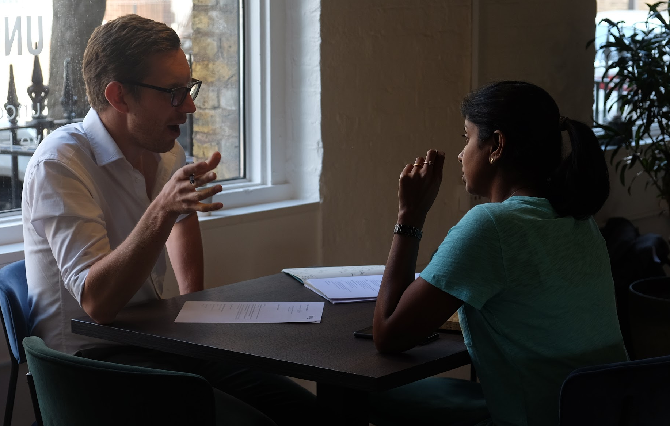
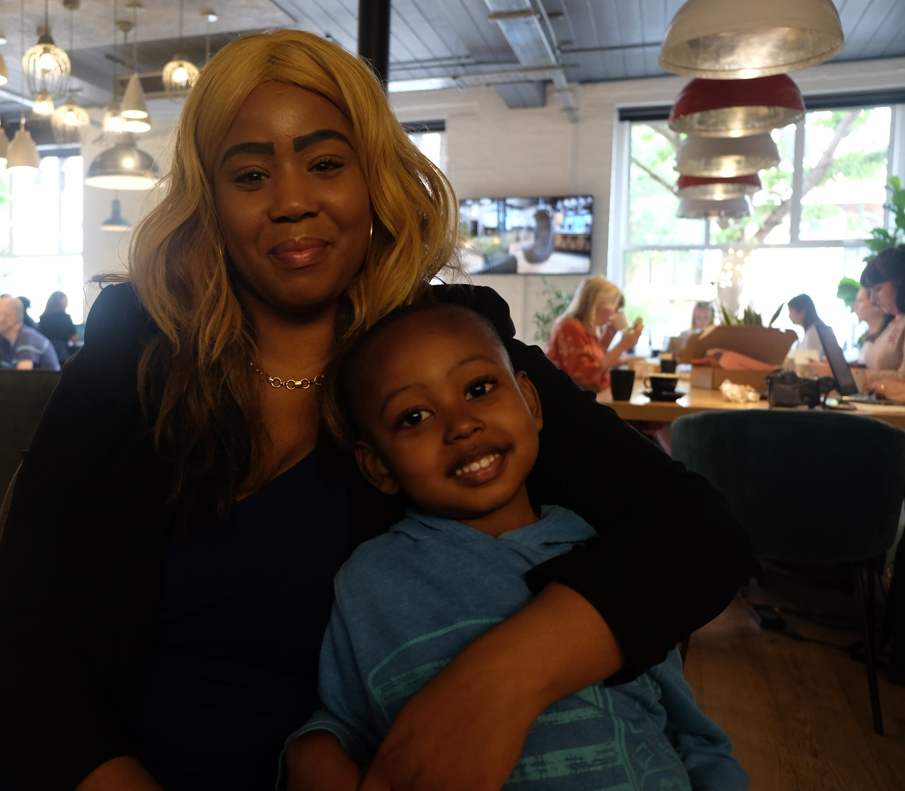
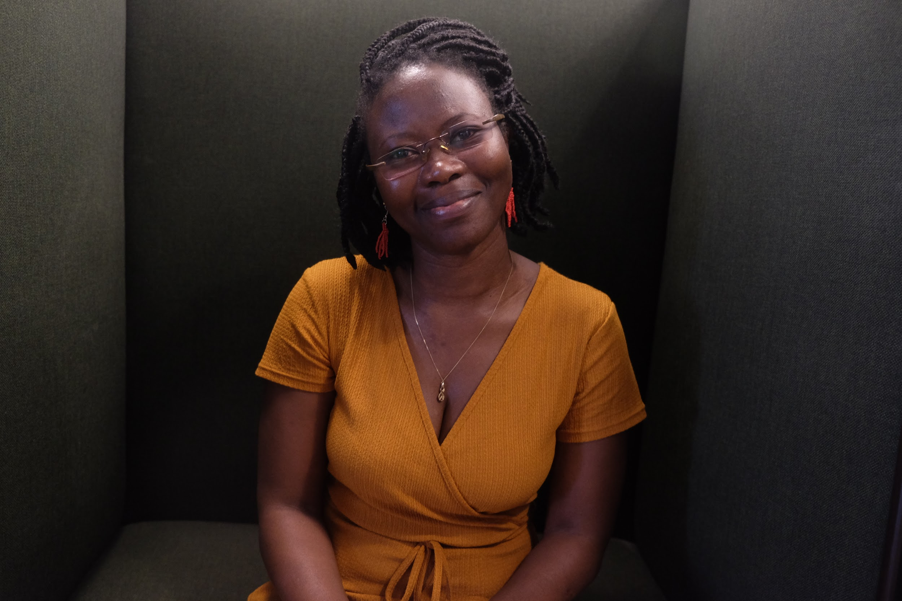
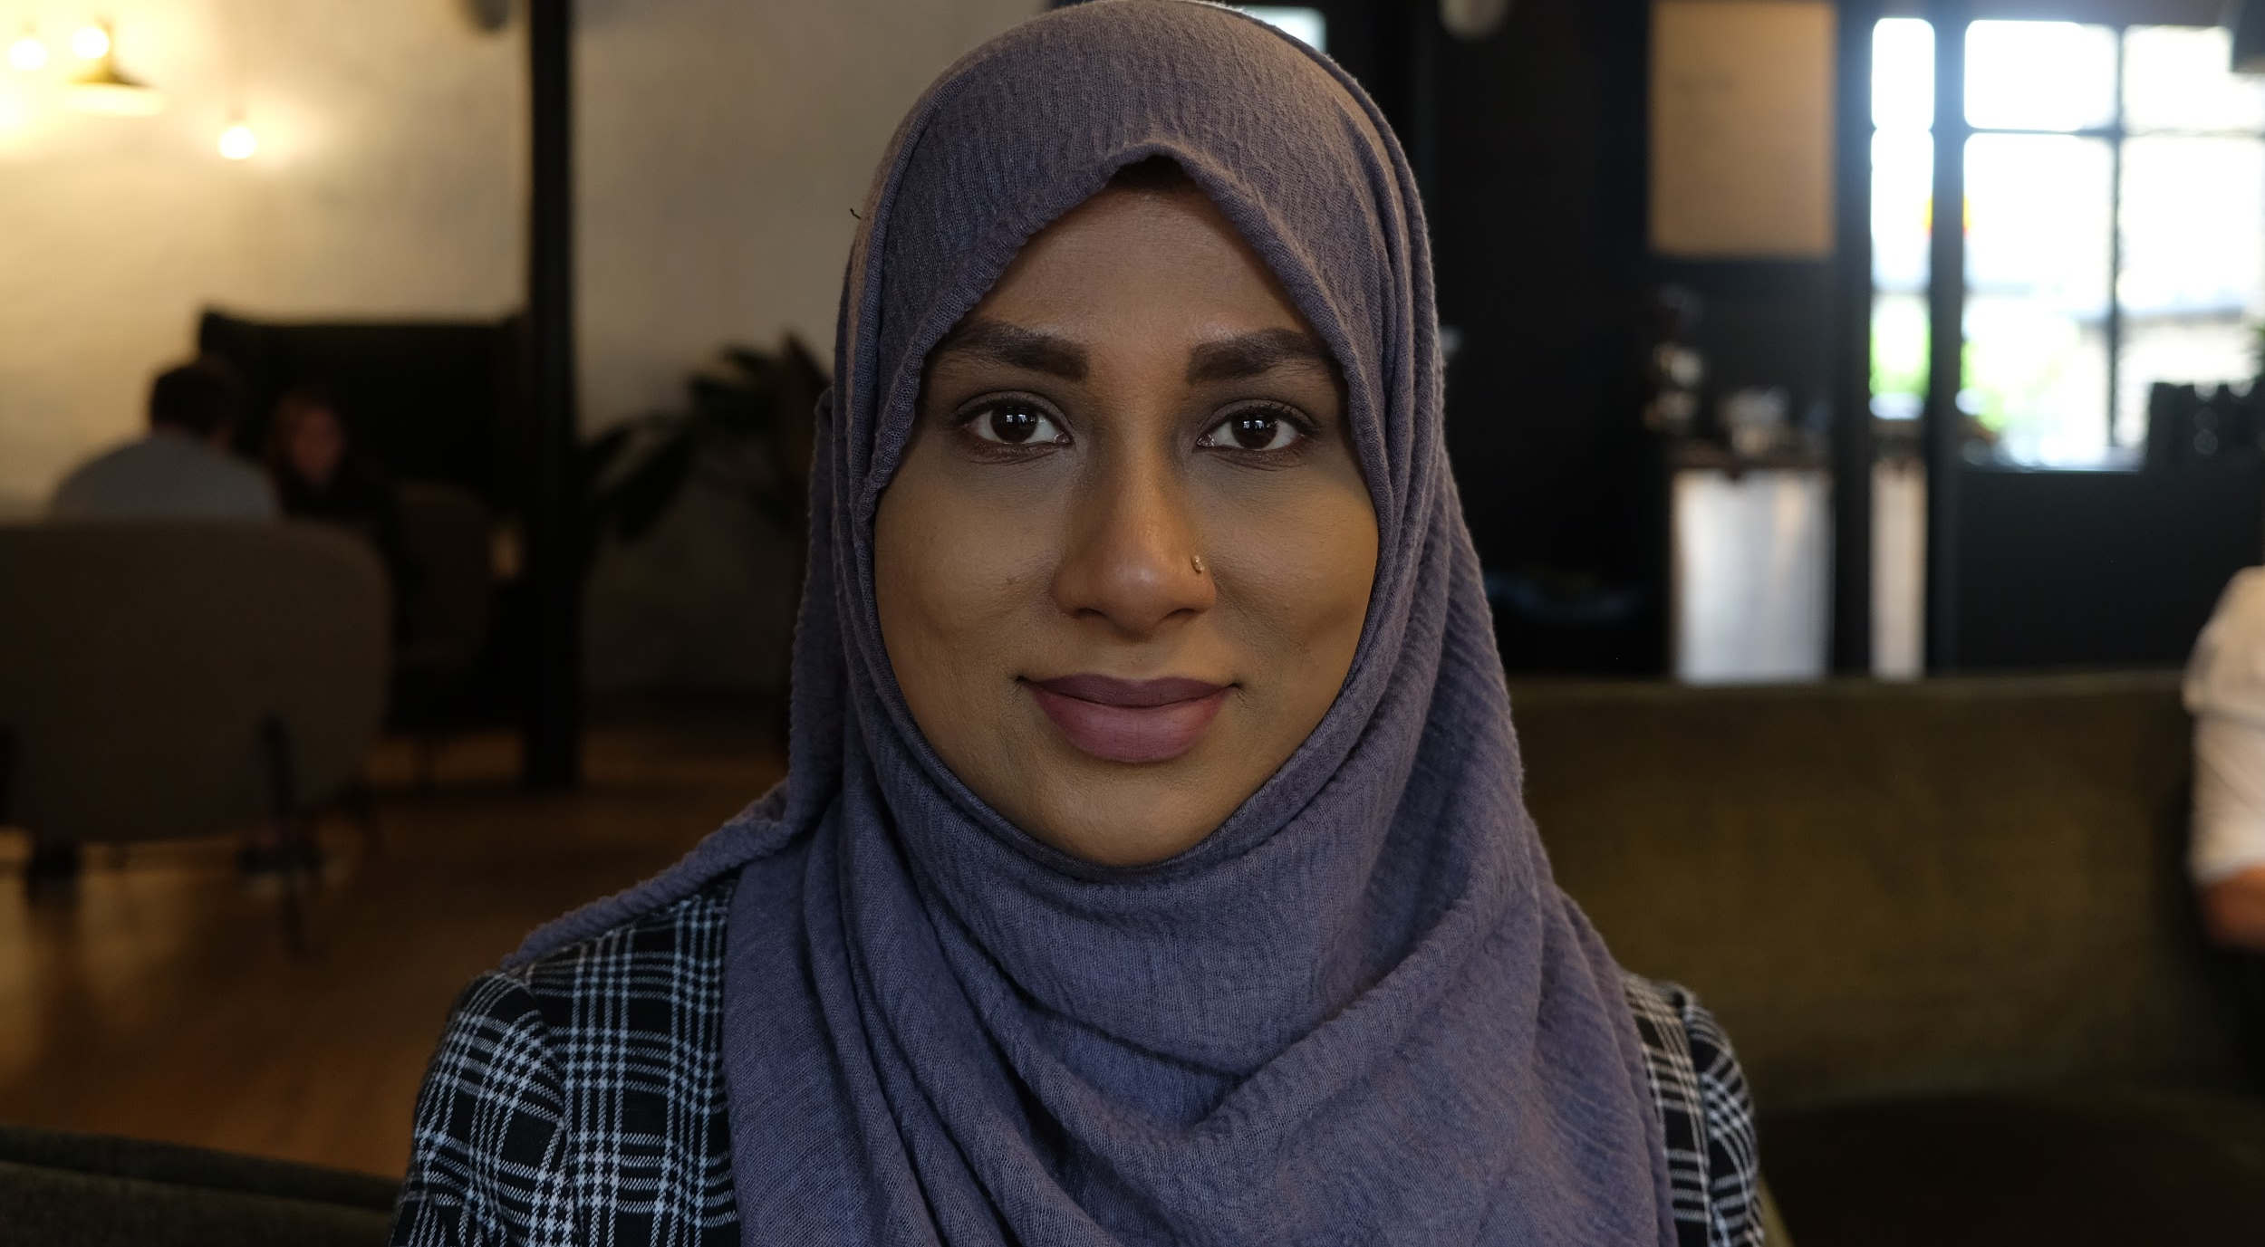
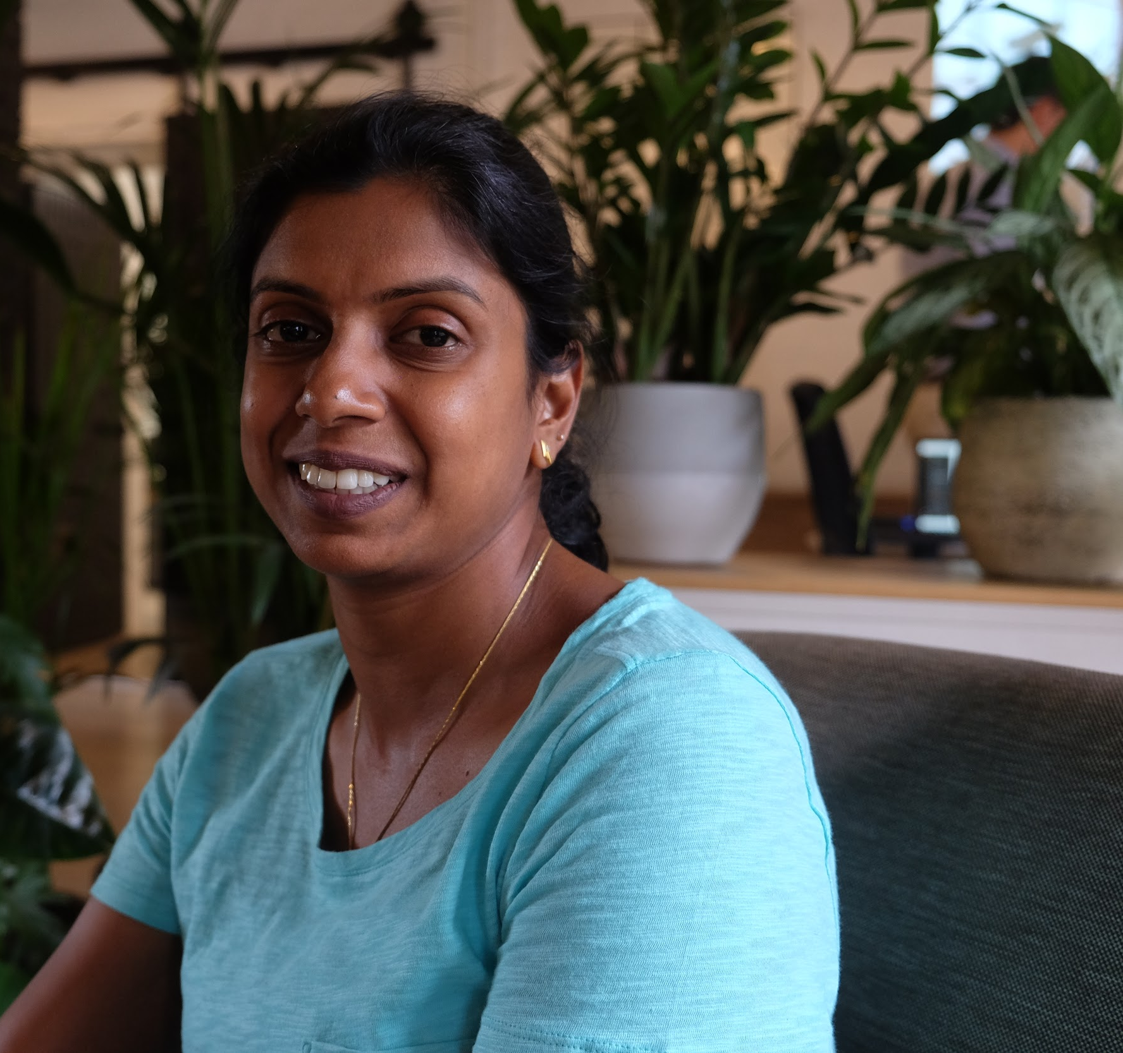
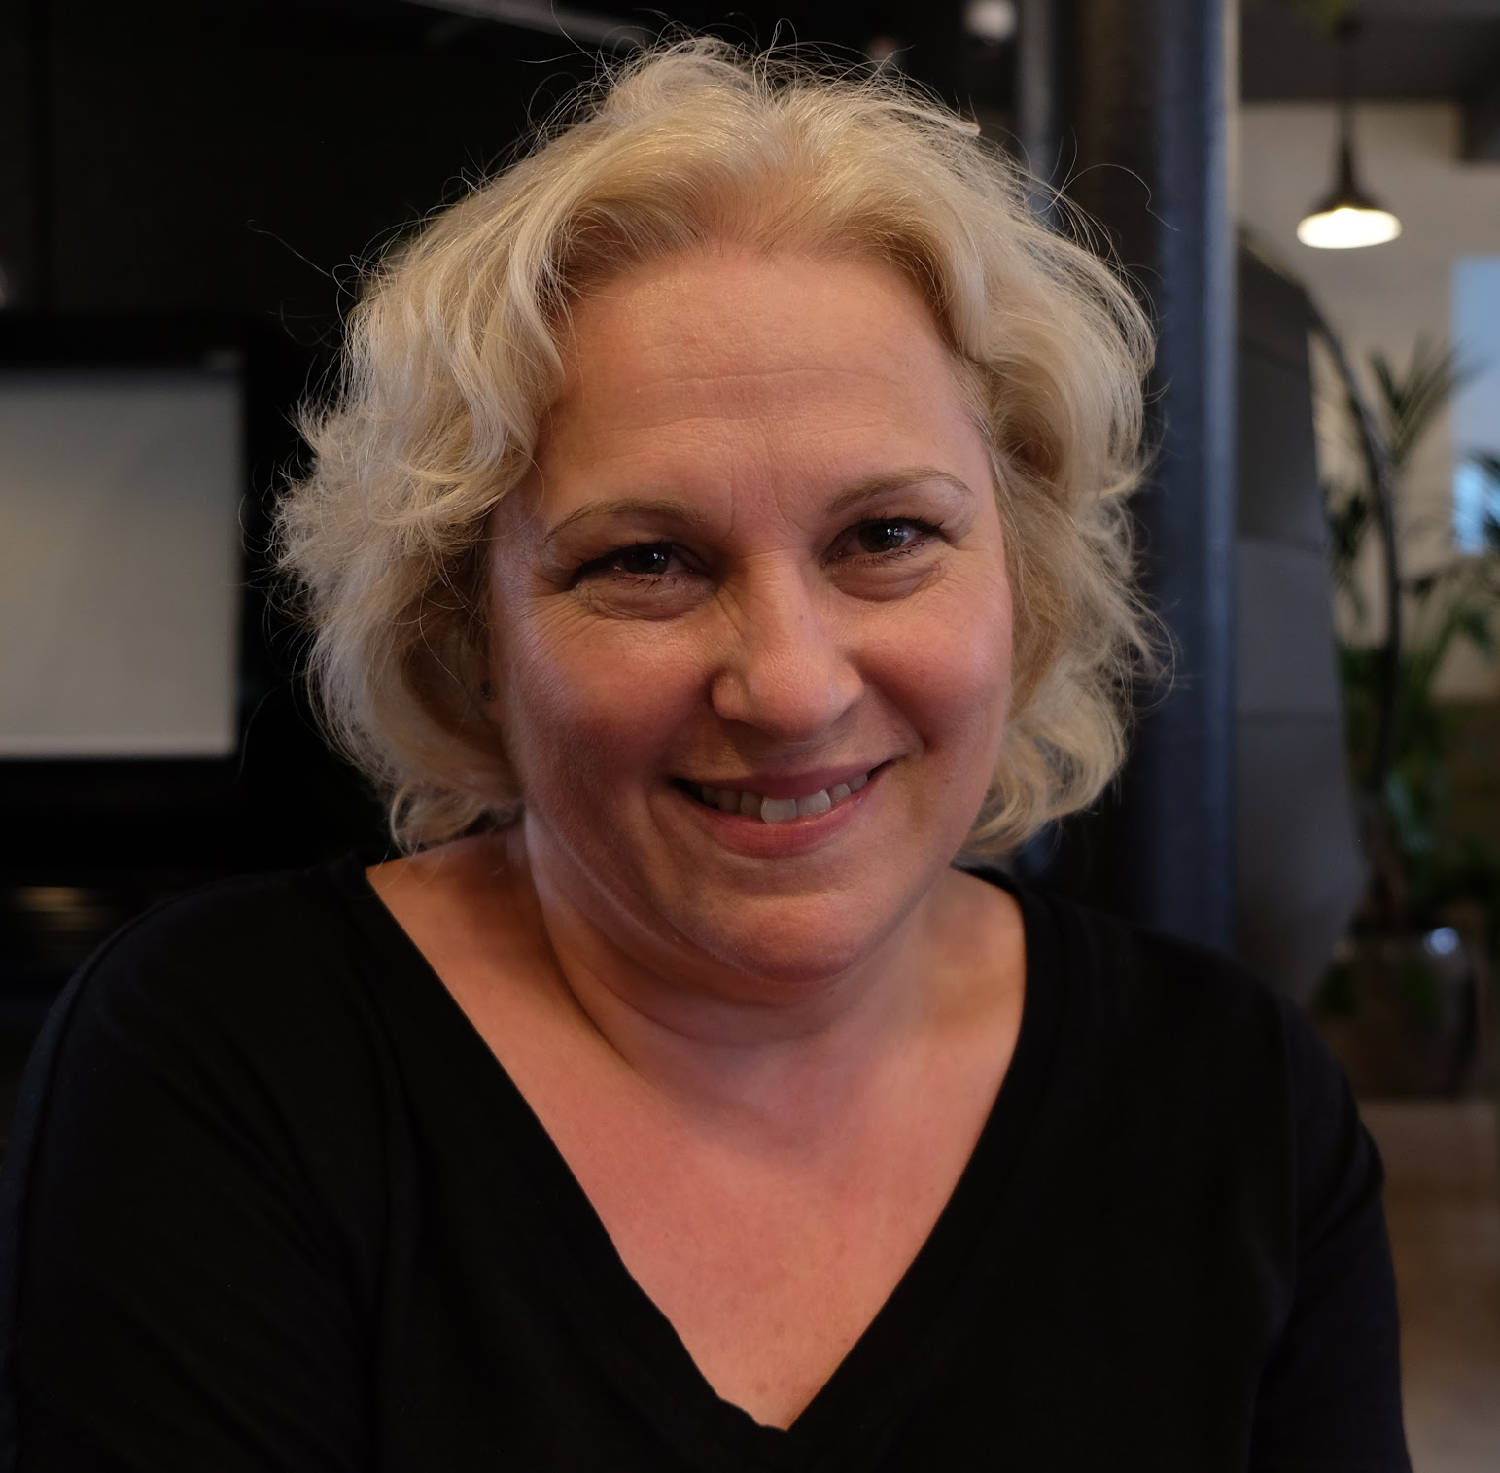
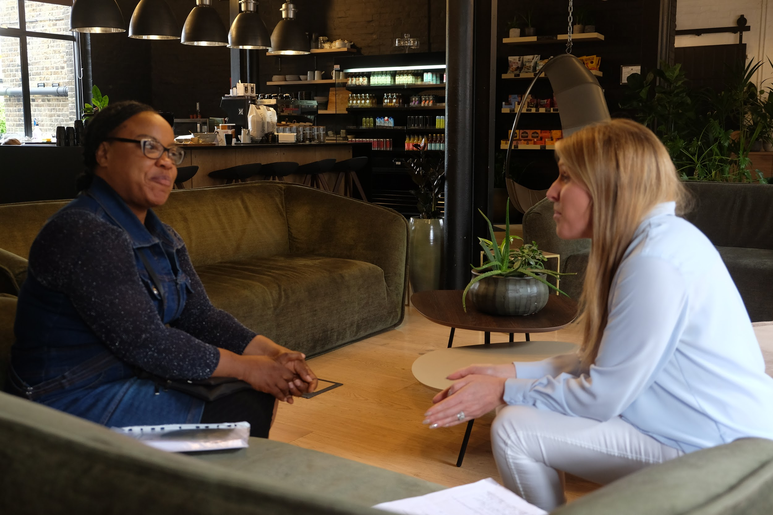
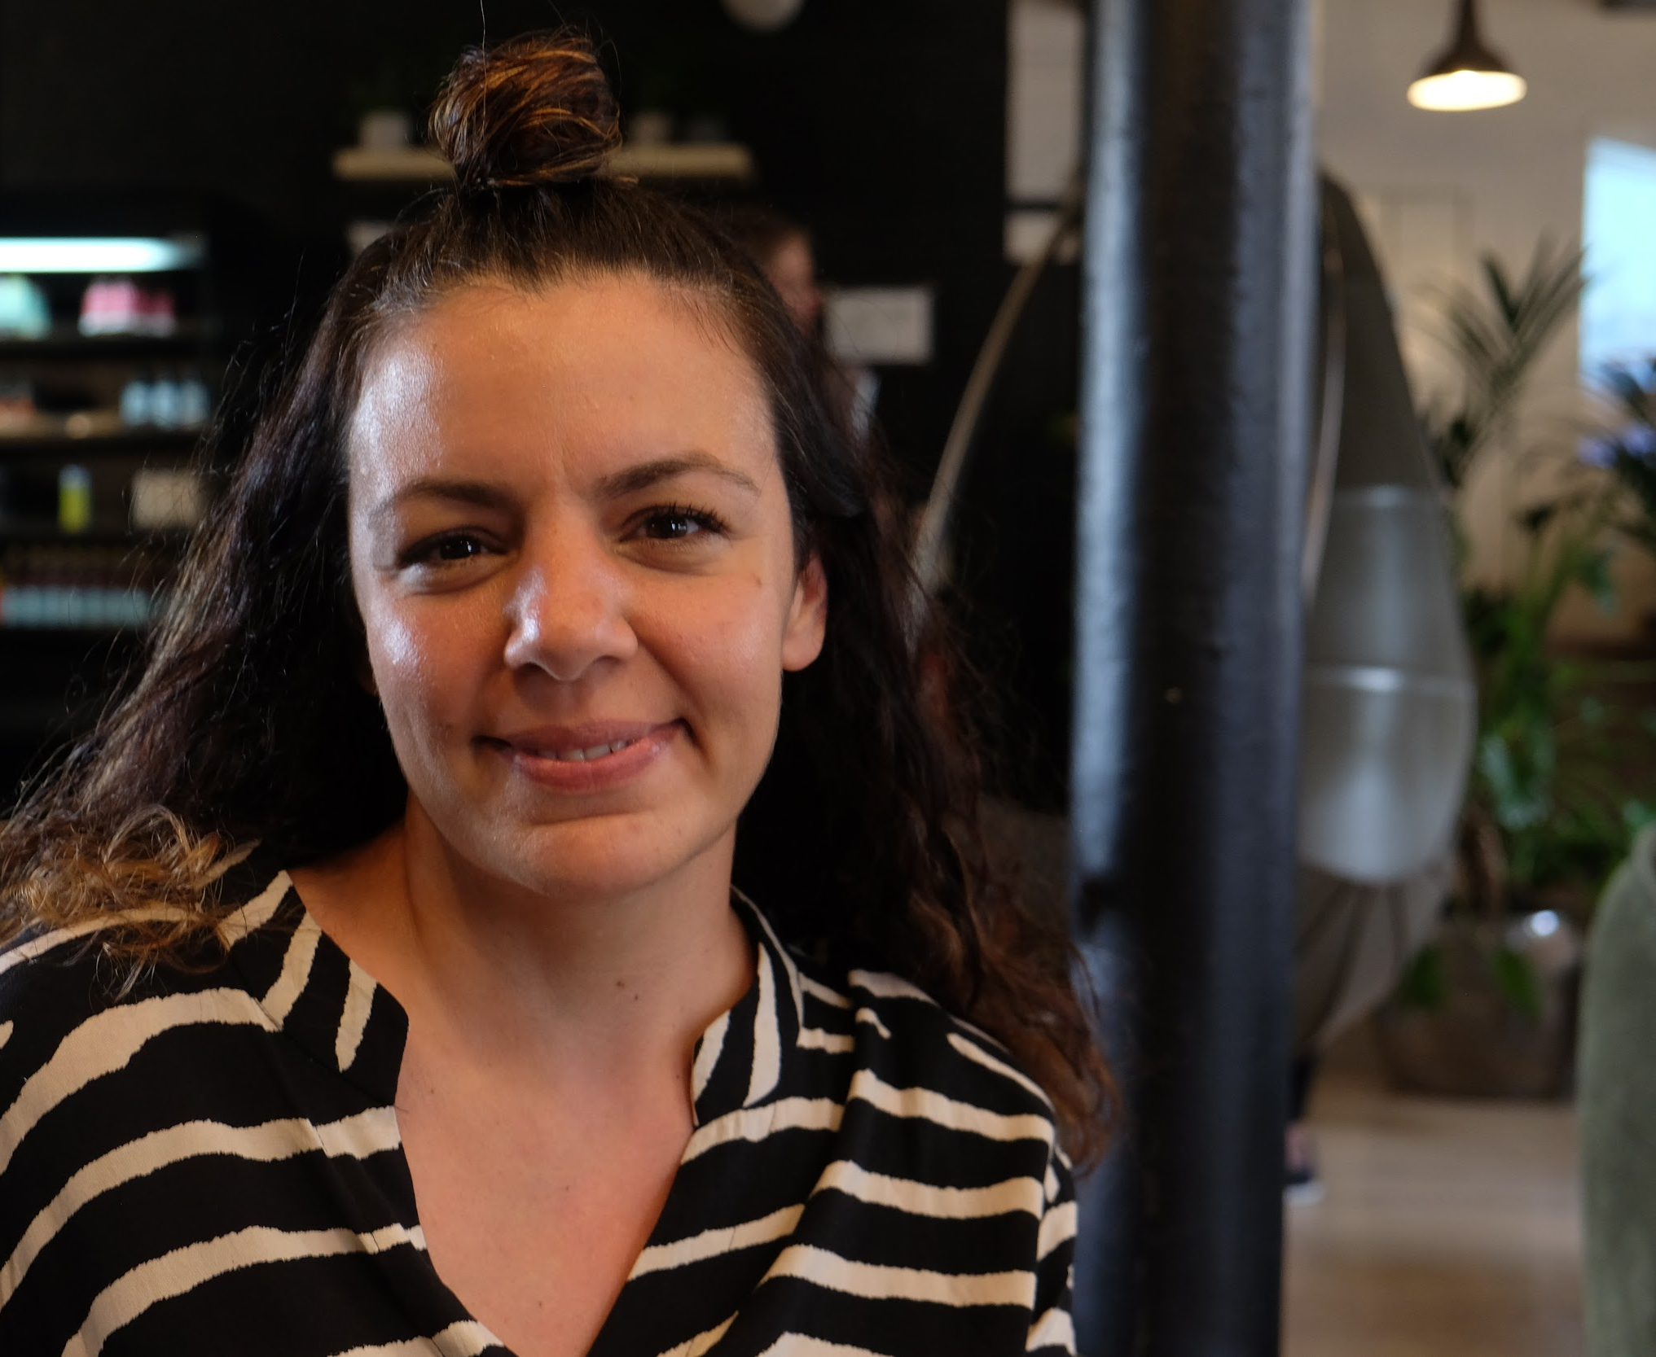
Train with tiney cohort 1 - tiney home leaders

Slide 13
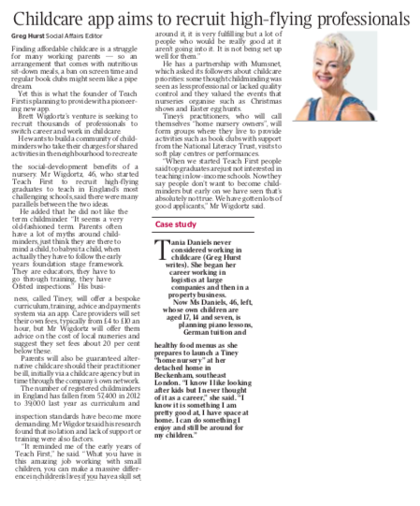
tiney applicant stories:
“I’ve been an Early Years Nursery Teacher for 8 years. After giving birth to my first child I was looking for a career that allowed for flexibility, for me to stay with my son, and also allowed me to stay in the field I love”
““I’ve been in the childcare industry for 5 years and after raising 6 children of my own had been trying to set up a nursery, but finding the property has proven extremely difficult. When I read about Tiney on Facebook, I was greatly encouraged! This is my dream, and to have a company that helps you set up in your own home and space was just too good to pass up!”
“I was drawn to the Tiney model because of the company Ethos, but also the support you provide to help get started which is a large obstacle for me as a mother & neither my husband nor I currently earning huge amounts of money.”

Slide 14
The customer experience for tiney home leaders
A fast way in to a long term childcare career
Application process through to training selection
Training, registration and setting opening
Becoming an established ‘tiney home owner’
Local tiney community leader / progression
4 weeks ( initial lead > application > interview)
8-12 weeks (training > registration > marketing)
3-24 months (run a profitable, high-quality and high-impact home nursery)
24 months+
(options to inspect other settings, take on assistants, lead local groups etc’)
Success =
Success =
Success =
Success =
‘Attract the right talent’
‘Ensure the right mindset’’
‘Create sustainable businesses’
‘Offer true career progression’’

Slide 15
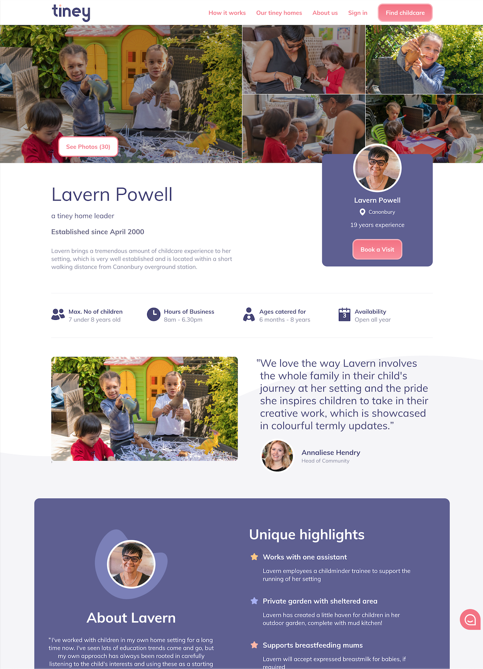
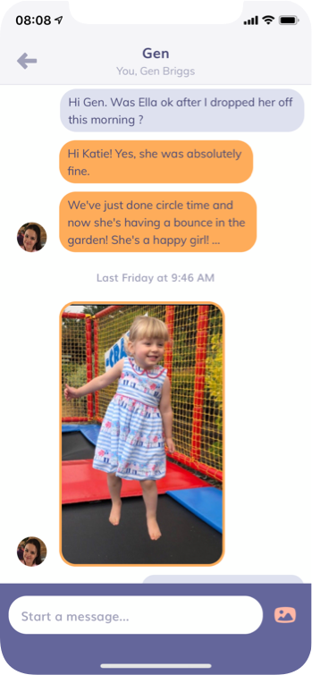
The customer experience for families
Chosen by parents, loved by children
Choosing
Using
Quality assured homes & guarantees
Evidence based education approach
Easy to see in to a ‘tiney home’
Easy to enquire and book a visit
Quick to get started
Simple mobile billings
Easy day-to-day communication
Fun and healthy for children
Flexible to request extras
Curated learning resources

Slide 16
At tiney we have a bold vision and the necessary expertise to create the future of childcare and build one of the world’s foremost education brands.
We are placing children at the centre of everything we do and believe that every child who spends time in a tiney setting will feel valued, have fun and leave positively changed.

Slide 17
brett@tiney.co
tiney.co
@wigdortz | @tineyco

