Slide 1
The Path to Adoption of Digital Securities- FTE Taormina
We deliver trusted global solutions for creating compliant digital securities.
24th July 2019
Visit us: www.securitize.io
Notes:
Thank you everyone for taking the time for this meeting, we are thrilled to be presenting Securitize to you all.

Slide 2
ABOUT US
EMPLOYEES
FOUNDED:
November 2017
35
12
Sales / Marketing / Ops
23
Engineering
HEADQUARTERS:
INVESTORS
San Francisco
OVER $15 M
Raised
ENGINEERING:
Tel Aviv
OFFICES
SF
NYC
TLV
LDN

Slide 3
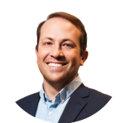
OUR STORY
In mid 2017, CEO Carlos Domingo decided to tokenize SPiCE VC, the VC fund he co-founded. When he was unable to find a satisfactory issuance and compliance platform for SPiCE VC, Carlos enlisted Shay Finkelstein and Jamie Finn to help build one. Together they created the compliance platform that successfully issued and maintains SPiCE’s security token. Once proven, word got out and demand for SPiCE’s security token issuance platform exploded. It was then that Securitize was born.
Carlos Domingo
CEO & CO-FOUNDER
Jamie Finn
PRESIDENT & CO-FOUNDER
Shay Finkelstein
CTO & CO-FOUNDER
25+ years of experience in innovation and digital transformation. Former CEO of Telefonica R&D and CEO of New Business and Innovation at Telefonica Digital. CEO, board member and investor of multiple startups
20+ years experience in startups, telecoms, + big data. Ericsson, Telefónica o2, and AVP of Product Innovation at AT&T. $700m In M&A transactions
Multiple startup exits
20 years of experience in leading engineering teams and building scalable technology, including Paypro Global, a major Europe-based payment gateway.
Notes:
Carlos Domingo was the CEO of Telefonica’s R&D and Innovation teams. Telefonica had 25000 employees and Carlos managed1500 engineers. He has also worked on smart city projects in Dubai. He has a PhD in Computer Science and speaks fluent Japanese.
Jamie and Carlos worked together at Telefonica. Jamie led acquisitions of a few companies, and ran the big data team of AT&T west coast US. He also built and scaled profitable tech companies.
Shay is an Experienced startup CTO, delivered a number of startups in the banking space, PCI
Carlos co-founded a VC fund called Spice VC, which he fully tokenized. Because he’s done it before, he and the team packaged this technology, which is what Securitize is.
Securitize is founded by Carlos Domingo, Jamie Finn, and Shay Finkelstein. Carlos was the president and CEO of Telefonica R&D and its Innovation teams. He has XXX education, worked on Smart City projects in Dubai. Jamie, our President, has over 20 years of experience including Telefonica, O2, and AT&T, he scaled Aki Technologies from $1m to tens of miliions in revenue and profitable. Shay Finkelstein has had over 20 years of experience in leading engineering teams and building scalable technology, including Paypro Global, a major Europe-based payment gateway.
Securitize was born when our CEO Carlos Domingo decided to fully tokenize the VC fund that he founded called Spice VC. In order to ensure global compliance for Spice VC’s tokenization, Carlos linked up with Shay Finkelstein, our CTO, and created the security token and lifecycle management platform to tokenize Spice VC. Having actually issued a security token, they packaged this technology and thus Securitize was born.

Slide 4
Access to capital is a massive, but flawed business
Add Real estate
Access to capital, by method ($ Billions)
Liquidity premium?
Private Offerings
Illiquid
Management overhead
IPOs
Expensive
Onerous reporting
Bonds
Expensive and illiquid
Requires collateral & performance
Syndicated Lending
Expensive
Only local liquidity
ICOs
Regulatory exposure
Insignificant portion of addressable market
Total
Sources: PwC, SEC, Dealogic, SIFMA, S&P Market Intelligence, Bloomberg, Financial Times, Reuters

Slide 5
These large markets are also riddled with inefficiencies
Long settlement time
It could take days or weeks to settle a transaction, depending on the type of security.
Extensive coordination between internal and external teams
Several teams need to coordinate at every stage of the bond lifecycle.
Expensive
Fees are required for various intermediary agents to facilitate trade execution & processing.
Data silos: Impediment to strategic planning
A lack of clean data to study historical trends and the ability to predict based on analytics.
Ineffective demand and supply matching mechanisms
Trades are facilitated over voice and manual searching among funds. It’s time consuming and ineffective.
Fractional ownership not possible
Impediment to liquidity and access to a wider pool of investors.
Heavy compliance burden
Retroactive audits and regulation activity. No immediate reporting mechanism.
Manual
Considerable friction between intermediaries due to no single source of truth.
Double spend problem
Manual processes mean no instantaneous updated record of asset ownership.

Slide 6
Blockchain technologies are perfect to address these issues
They record ownership through a cryptographically secure shared leger.
Solve multi stakeholder collaboration problems without the need of a central entity.
Decentralized trustless collaboration and information sharing and reconciliation on top of existing systems.
Full transparency, auditability, and traceability when necessary, but full privacy most of the time.
Instant settlement capabilities, including monetary interactions, free bank capital, and de-risking the settlement and clearing process.
“One-hundred percent of the stocks and bonds trading on Wall Street today COULD be tokenized, and in five years, one-hundred percent of the stocks and bonds on Wall Street WILL be tokenized.”
Robert Greifeld | Former Chairman & CEO of Nasdaq

Slide 7
Blockchain based security tokens (digital securities) provide a better way to access and manage capital
Tokenized securities using smart contracts can provide a seamless & automated way to raise capital, manage investors, and improve liquidity.
Compliance
Programmable
Liquidity
Built-in global regulatory compliance coded into the token and protocol levels.
Self-executing investor & issuer rights (dividends, buybacks, etc…).
Access to global markets 24/7/365.
Fractional Ownership
Transparent & Immutable
Efficient & Time Saving
Driving further liquidity for Issuers and Investors (Equity, Bonds, Commercial Paper, VC Funds, Real Estate and many more financial instruments).
Providing more direct and certain ownership to Investors.
Eliminate friction and middlemen, and save time for faster settlement.
Notes:
Digital securities modernize capital by upgrading a traditionally illiquid, tedious and costly process.

Slide 8
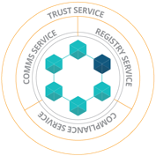
Securitize is an end-to-end platform and protocol for issuing, managing, and enabling liquidity for security tokens
ISSUANCE (PRIMARY ISSUANCE)
SECONDARY TRADING (EXCHANGES)
LIFECYCLE (EXECUTION OF TOKEN RIGHTS)
Wallet
Management
Compliance Enforcement
Investor
Dashboard
Security
Token
Issuance
Governance
Cap Table
Management
Economic
Rights
Investment
Funding
Document
Signing
Issuer
Communications
New Investors (Via Trusted Security Exchanges)
Investor
Onboarding
(KYC/AML & Accreditation)
Enable
Compliant Trading
Freeze, Burn,
Reissue
Upgradeability
Notes:
What is Securitize on a high level? What does it mean to issue a security token?
Securitize is the complete platform for issuing digital securities on Blockchains.
There are 3 components to the product: 1. Primary issuance of the digital security (when the digital securities are minted), using the digital security protocol, we can ensure that the issuance and management of the digitatl security will be compliant against the regulatory framework chosen by the issuer. Because our technology is based on the ERC20 standard, issuers can have direct custody and manage their own private keys. If somehow a wallet is stolen, we have a investor relations group that works on dispute resolution and will work to understand what has happened, and via our platform, we will burn the securities in the stolen wallet, and issue new securities to a new wallet that is registered with the system.
The second component is liquidity, with compliance built into the digital security that manages how its traded, and who is allowed to invest in the digital security. We have numerous, licensed exchange partners that integrate with out product so that we can actually provide compliant life cycle management of the security. Compliance is an ongoing process.
Which brings us to the 3rd part, the life cycle management that includes governance of the digital security. For example, some issuers want to issue digital securities that are not just common stock without voting rights.We have governance features including economic rights, such as dividends or interest, buy backs, redemption, freezing and burning, and most importantly cap table management and upgradeability. With blockchain we can implement those in a transparent way.
Blockchain Capital issued an unregistered security through an ICO in 2017, and decided to work with us to upgrade their token. Blockchain Capital’s ICO private sale included 68 investors, but decided to change that to 99 people. With Smart Contracts, all of these can be customized.
Eg.,
People don’t know who holds FB shares, If facebook wanted to reward investors who have been holding FB for the longer, their votes can amount for more weight

Slide 9
Securitize is well integrated in the ecosystem
Custodians
Liquidity Partners
Broker Dealers
Advisory & Legal

Slide 10
The Market Leader
The only company in the industry with security tokens issued & trading powered by a digital securities protocol on the blockchain
Issued
Trading
19 STO launched or pending issuance
STO Launched or Pending Issuance
Notes:
Blockchain Capital, Science, Spice VC – all moved to Securitize
Elevated Returns
In the US already
All tokens being traded in the US are done by Securitize

Slide 11
Case Study: SPiCE VC
The issuance of the token that represents LP Interests in a VC Fund
Token Price | I SPiCE Token = $1
Economic Rights | Realisation BuyBacks, No distribution Dividend or Voting Rights
Min. investment | $50,000
Offering size | $15m
Issuer | Spice VC Invest Proceeds in StartUps
Deal structure | Private Reg D 506 (c) and Reg S offering Equity ownership in LP Fund and direct share of net assets
1st fully tokenized VC Fund
4th ever Security Token
1st token issued on a globally compliant security token issuance platform
1st fund focusing on the tokenization space
1st security token to trade on a regulated platform(OpenFinance Network)
1st security token fund to entitle holders to a direct share of net exits
Trading- Yes
Notes:
Securitize is the only company with tokens issued, listed and trading today
Blockchain Capital, Science, Spice VC – all moved to Securitize
Elevated Returns
In the US already
All tokens being traded in the US are done by Securitize

Slide 12
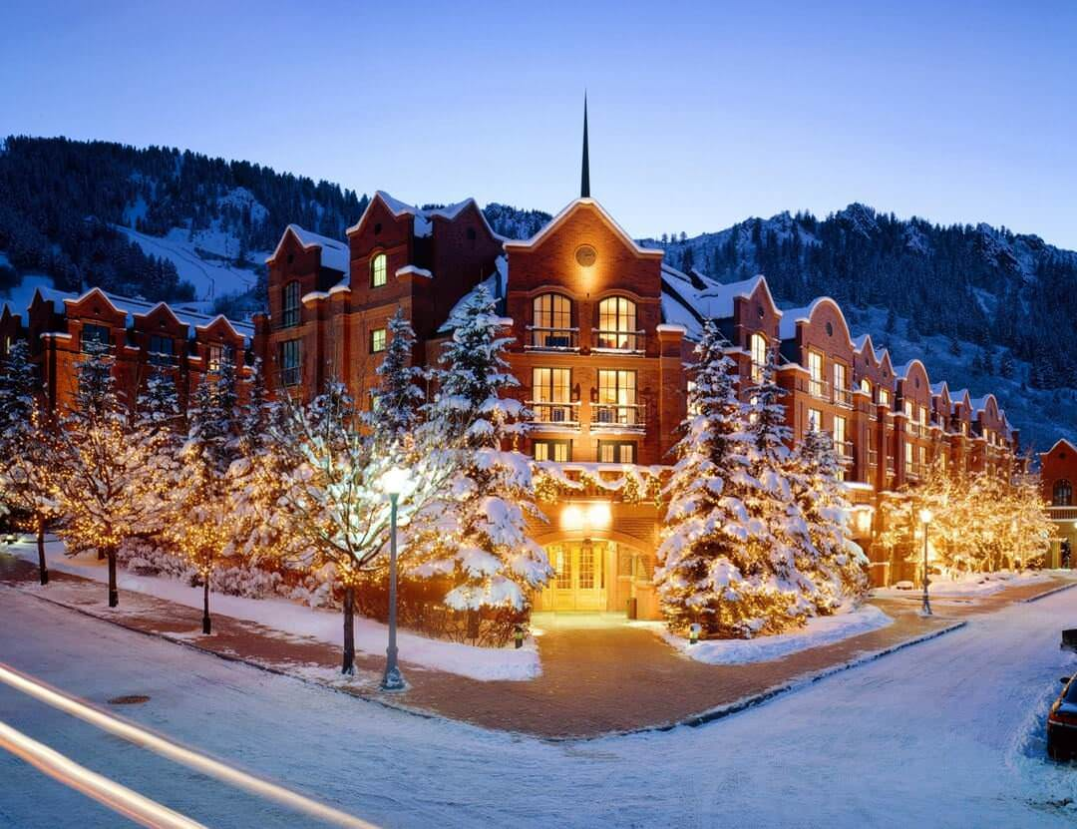
Case Study: AspenCoin
The issuance of the token that represents St. Regis Aspen Colorado Resort
Token Price | $1
Economic Rights | Dividend paying
Min. investment | $10,000
Offering size | $18MM
Issuer | Aspen Digital A single-asset REIT and currently intends to own only the St. Regis Aspen Resort.
Deal structure | Private Reg D 506 (c) offering Indirect fragmented equity ownership for accredited investors
The St. Regis Aspen Resort is a full-service, 179 guest room, luxury hotel located in Aspen, Colorado with an upscale restaurant, a private spa and heated outdoor pool with panoramic views of the Aspen mountainside.
Trading | Not Yet
Notes:
Securitize is the only company with tokens issued, listed and trading today
Blockchain Capital, Science, Spice VC – all moved to Securitize
Elevated Returns
In the US already
All tokens being traded in the US are done by Securitize

Slide 13
Securitize’s Product Suite
Early Adopters
Public Blockchain
REIT
Venture Fund
Institutional Customers
Permissioned Based Blockchain
Equity
Revenue Streams
Debt
Commercial Paper
Bonds
Loans

Slide 14
The fixed income segment is a huge a growing market ready for disruption
3X
$9T
$1T
$3.5T
$700B
Growth in the US bond market in the last 15 years.
Corporate bonds outstanding in the US with $1.34T issued in 2018.
Projected structured credit markets in 2019.
Global syndicated lending in 2018.
Bonds that are traded daily.
More than 3X stocks ($200B daily).

Slide 15
IBM Blockchain Partnership
Check with the quotes here
We have participated in the first edition of the IBM Blockchain Accelerator, a growth program to work on a use case with IBM.
We have jointly identified fixed income and specifically commercial paper issuances on the blockchain as the main use case on which to focus and already secured one of the worlds ten largest bank as a partner for the project.
We are building a permissioned based blockchain to tackle this problem as oppose to our current approach using public blockchains due to the more institutional nature of the target customer of this project.
IBM treasury department is evaluating being the first company to issue commercial paper in this new network.
We have signed an MoU with IBM and we are in the process of signing a collaboration agreement with them and recruit other companies (broker dealers, investors, law firms, etc.) to launch the first issuance.
IBM is working with Securitize to tokenize corporate debt, which is an $82 trillion market annually, and securitization of this asset offers significant time and cost efficiencies to the existing process. The IBM treasury issues billions in corporate debt every year and will be running a piece of this through Securitize’s platform this year.

Slide 16
SHIELD: Securitize Hyperledger Issuance of Electronic Loans and Debt
A better debt marketplace facilitated by blockchain as a collaboration platform
INFORMATION/ DOCUMENTAL TRACKING
PRICE DISCOVERY
TRADE EXECUTION/ SETTLEMENT
COMPLIANCE

Slide 17
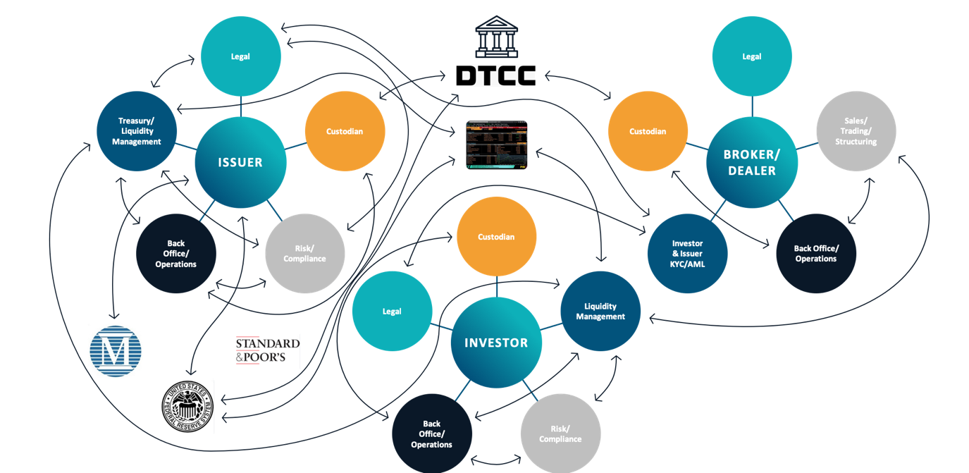
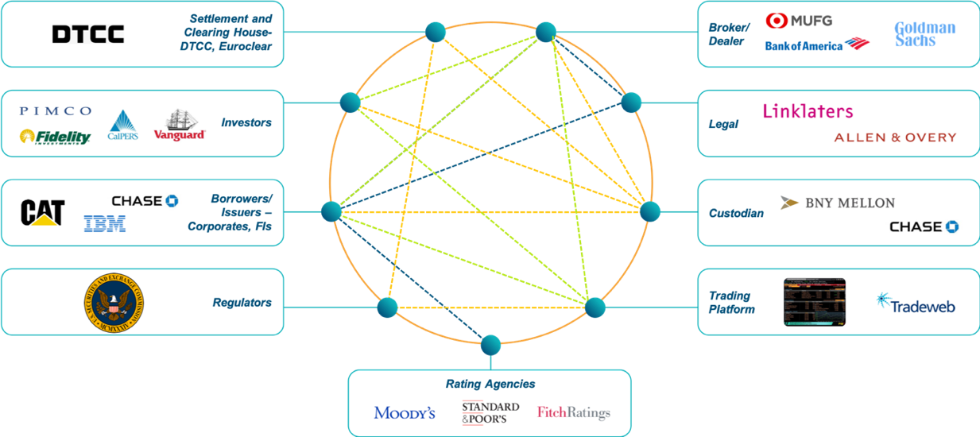
SHIELD has the potential to revolutionize current entangled centralized market structures
TODAY
TOMORROW
Centralized Ledger
Distributed Ledger

Slide 18
Conclusions
Capital markets are massive markets riddled with inefficiencies due to poor digitalization and dependence on multiple disparate systems and a number of intermediaries.
Digital securities issued with blockchain technologies are the perfect solution to address many of those inefficiencies and are now mature enough for robust institutional usage.
Securitize is the leading security token issuance and management company with the largest amount of issuances that are live, with 7 and many more coming.
We are also the only issuance platform whose protocol is currently enabling compliant trading of securities on public blockchains and two exchanges.
We have tokenized funds, equity on operating business, and real estate. We are now moving into corporate debt in partnership with IBM, and are supporting both public and permissioned based blockchains.

Slide 19
Contact:
Breige Tinnelly
Head of Europe
breige@securitize.io

