Slide 2
Future of Privacy
Derek G. Roga
Founder and CEO, EQUIIS Technologies

Slide 3
Our Personal Data Has Been Compromised

Slide 4
Our Data is Compromised
Is this
ethical?
Digital Footprint - Everything we do online, actively and passively, leaves a digital trace
Third Parties are accessing our data; most times legally, but often times, without our knowledge

Slide 5
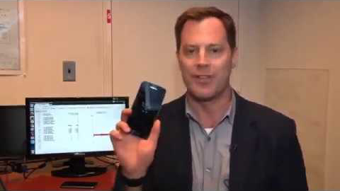
So Who Really is Big Brother?
https://www.youtube.com/watch?v=S0G6mUyIgyg&feature=youtu.be

Slide 6
Big Tech Uses our Data to Make Billions
Estimated Revenue
$5 Billion
$36.33 Billion (Q1/2019)
$14.9 Billion (Q1/2019)
Per user
$4 per user
$58.08 per user
$7.37 per user
Sources: Forbes, Business Insider, investor.fb, Motley Fool

Slide 7
Our Changing Sentiments Regarding Trust in Corporations
Recent Data Breaches
Mistrust in Big Corporations
64%
cannot name a single company that they trust to handle their data
25%
of customers won’t share any of their personal information with organizations
British Airways-Hackers stole 429,000 credit card records from customers
Cambridge Analytica
Marriott- 500,000 passport numbers were stolen
Over
87 million people affected
Full ramifications on the U.S presidential election and Brexit are still unknown
Facebook-540 million accounts exposed on Amazon Cloud Servers

Slide 8
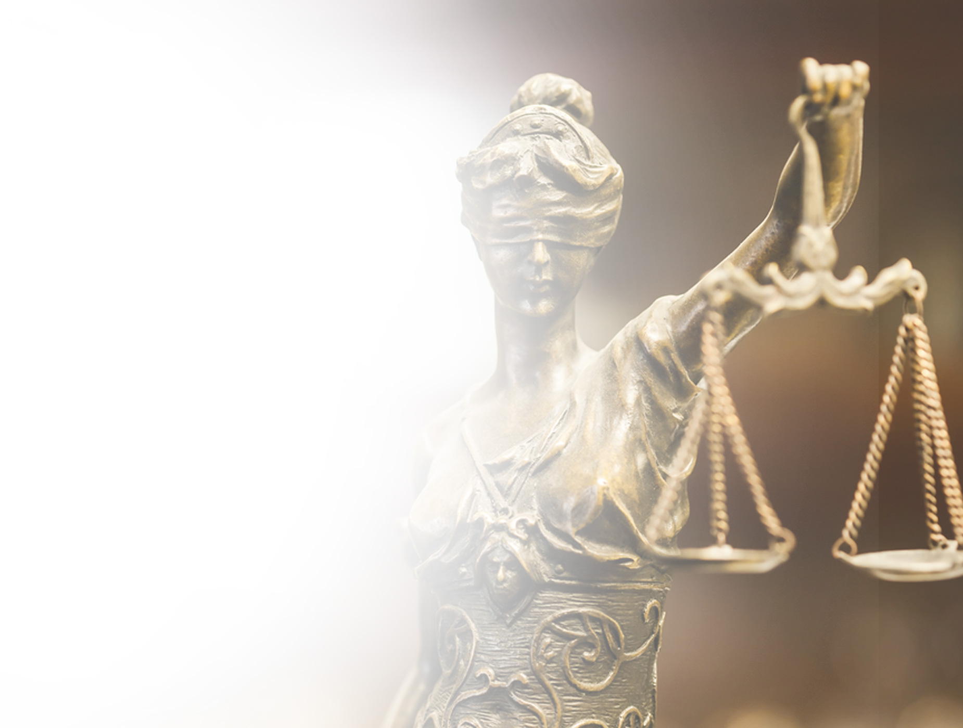
Implementing and Enforcing Regulation

Slide 9
How do we Get Access to the Data Third Parties Have on us?
Third parties, because of GDPR, now have 30 days to reply and fulfil our requests for our data. BUT..
1
The data doesn’t have to be organized
2
They can pick and choose what data to send us
This makes deciphering the data even more difficult for us

Slide 10
Europe is at the Forefront of Regulation
GDPR-Europe
CCPA-California
LDPD-Brazil

Slide 11
Legislation as a deterrent
Sanctions need to be
Meaningful
Punitive
Enforceable
Data Privacy News
Google’s Nest Cam spied on people in their own home
Google gets a fine for GDPR in January 2019 for 50 Million Euro and are still fighting it
Apple has found that iPhone apps pass data to third parties, even when users are sleeping
“
Facebook users should not have any “reasonable expectation of privacy”
Attorney Orin Snyder representing Facebook in court

Slide 12
There is a real solution

Slide 13
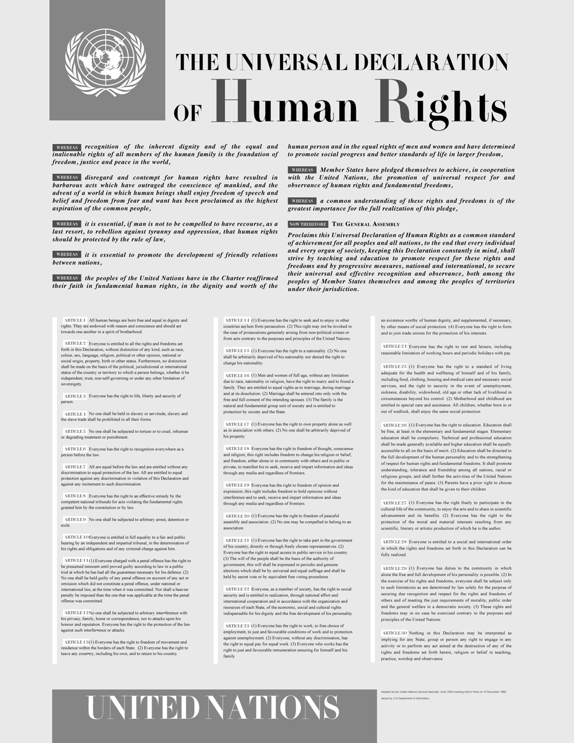
Owning Our Data Should be a Basic Human Right
Privacy is a basic human right- Article 12 of the United Nations Declaration on Human Rights
1
We should all realize that our data is a valuable asset
2
Our personal IP should be owned and protected just like any other valuable asset

Slide 14
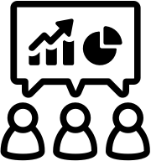
Education on our Personal Data is a Process
Being better informed on how our digital footprint is created
Knowing how it’s used
Managing our own data proactively = Data Hygiene

Slide 15
Corporate Obligations on Consumer Rights
1
Tell consumers what data they are collecting from them
2
Re-evaluate the types of data they collect and for
how long
3
Publicly disclose detailed information about data breaches more frequently
Source: CEO of the Identity Thief Resource center

Slide 16
Personal Data Vault
Personal data as a “property right” of ownership
Indexed digital
footprint
Data dashboard – one shot view of our indexed data available at our fingertips
Monetization
value

Slide 17
Thank You
Media Contact media@equiis.com equiis.com

