Slide 2


Distressed Investing
An idea whose time is coming

Slide 3
The Opportunity: Fragmented debt market in Emerging Europe means increasing number of interesting situations, mostly too small for global traders, too big for local capital
The Team: Experienced investment managers with a track record in distress and emerging markets and boots-on-the-ground.
The Strategy: Acquire underperforming corporate debt, real estate loans and granular portfolios of NPLs in Central and Southern Europe, focusing on investment size between €5-€20M
Benefits for the Investor: Excess of 20% IRR, with good liquidity profile, and access to a new and increasingly important geography.

Slide 4

Why distress?
Countercyclical
Superior returns
Value preservation

Slide 5
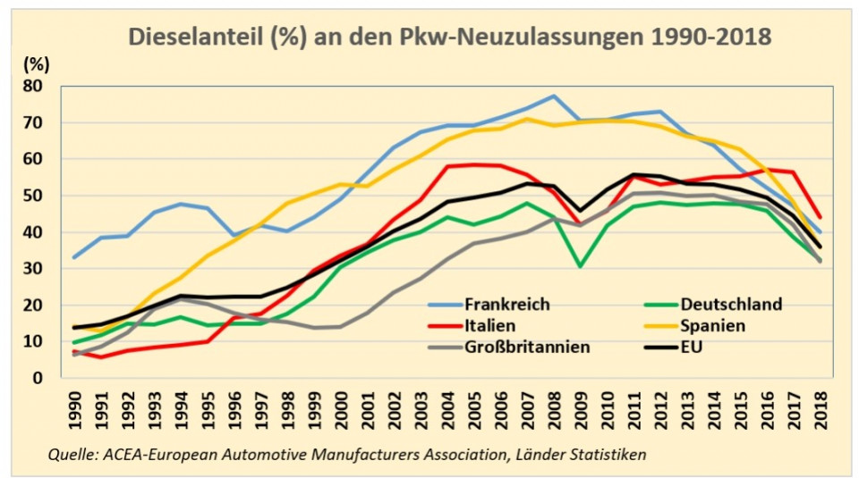
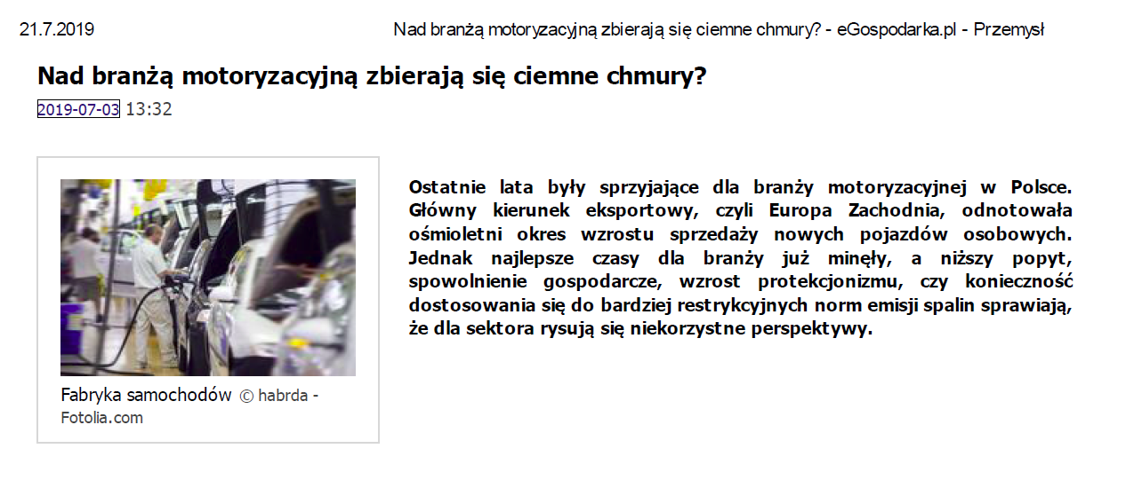
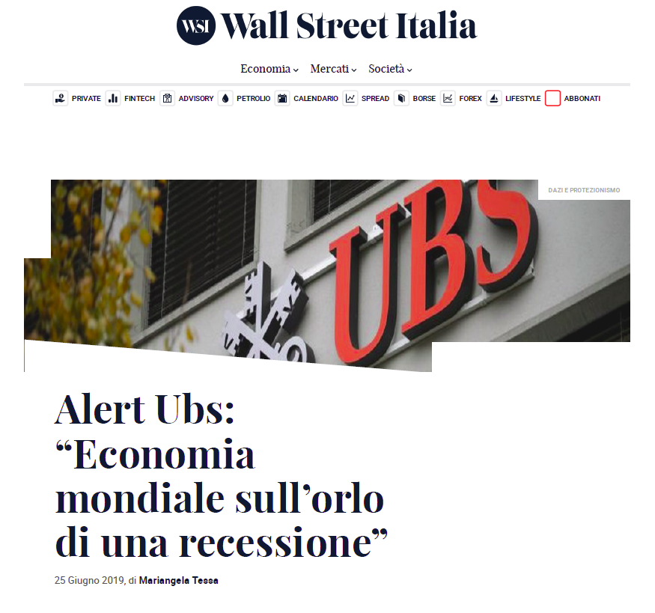
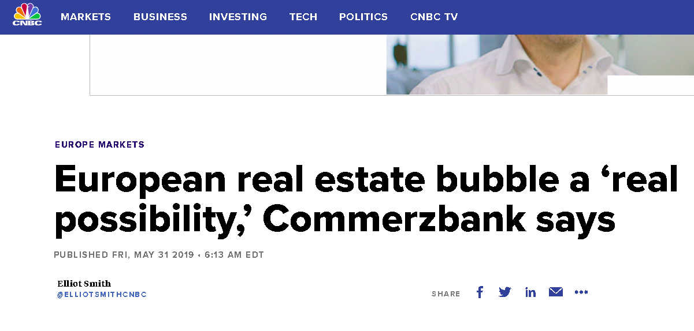
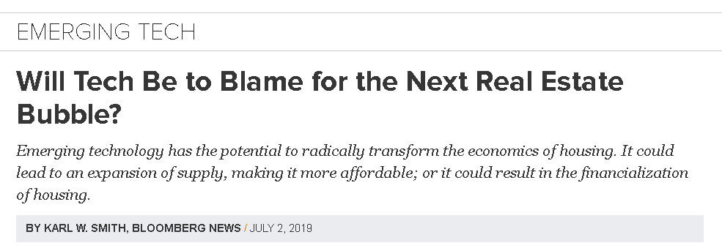
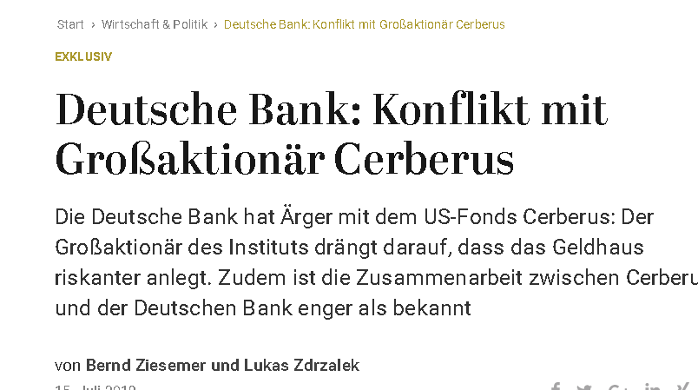
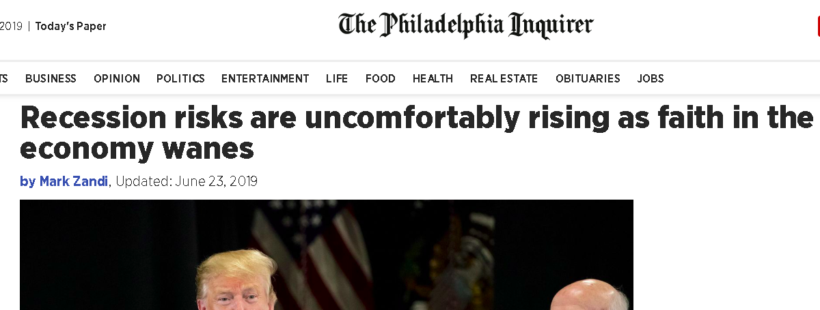
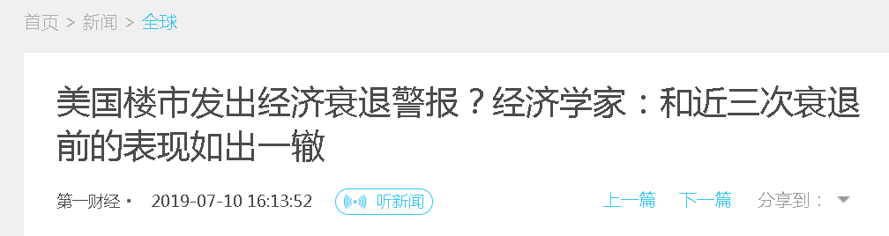
Are we headed into the next cycle?

Slide 6
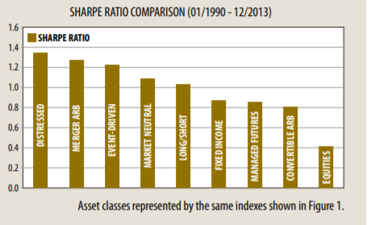
Superior Returns?
Globally
In the decade since the 2008 Financial crisis, the Eurekahedge Distressed Debt Hedge Fund Index has returned 11.12% on an average annual basis.
Central and Southern Europe
Market is still nascent, early mover advantage is still possible
Region is still underbanked, creating price advantage for alternative credit
Yields in CEE on NPLs range from 10% to high 20s.

Slide 7

How do we do it?
Implementing an appropriate strategy successfully requires a particular set of skills.
Distressed investing is not easy, but for those firms with the appropriate professional skills and capital base distressed investing strategies can be extremely profitable.

Slide 8


Distressed investing is more than picking the bones

Slide 9
Preserving Value
Cumulative value proposition
6
5
Equity kicker at exit with 3-5 yrs investor window
4
Equity stake
3
Operational improvements
2
Asset sales
1
High yield (10-15%) refinancing with super senior debt
Discounted purchase price
Value Levers

Slide 10
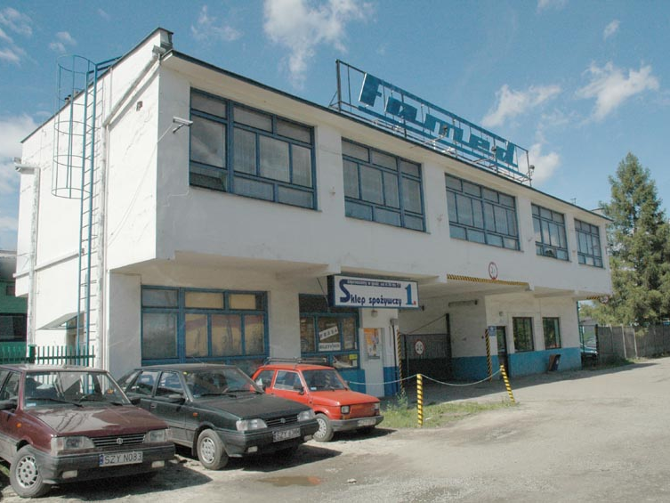
What have we done?

Slide 11




Rebirth

Slide 12

Today

Slide 13
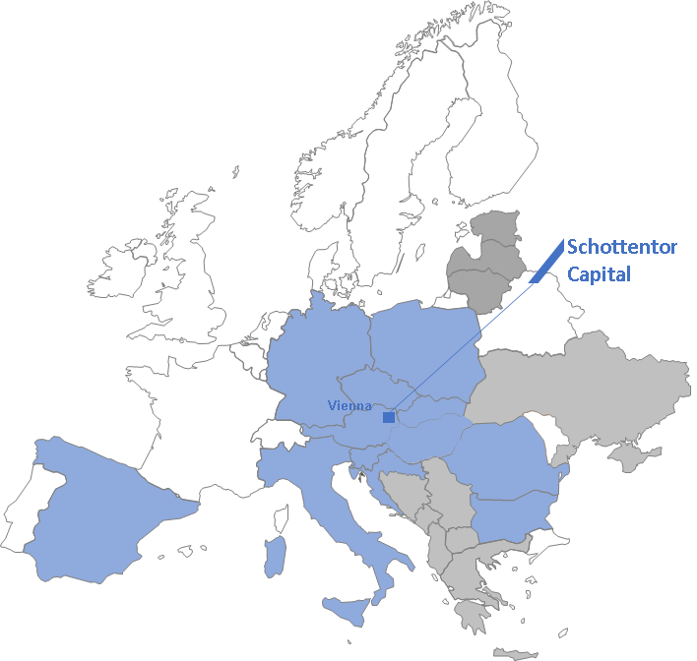
Where do we find the opportunities?
Geography
Industries
Germany
Spain
Poland
Romania
Italy
Banking
  Overhang of NPLs/UTPs still significant
Automotive
  Hitting the wall?
    Diesel
    Digitalisation
    Car/ride sharing
Real estate
  Real estate accounts for over 70% of all global mainstream assets
Retail
  Overbuilding, omnichannel digitalization and changing consumer demand

Slide 14
How do we manage risk?
Enforcement
  Grab the “blocking position”
  Consensual, when it makes sense
  Stay close, stay relevant
Know the jurisdiction
  Extensive due diligence
  Legal network and local partners
Experience
  Decades on the ground
  Strong network

Slide 15
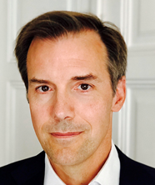



Who are we?
Schottentor Capital is a specialized asset management and advisory firm, founded by partners with successful business track records in Central and Southern Europe.
We are a proud member of the Chatham Lane Asset Management Family, alongside Promethos Capital and exciting strategies still to be announced.
Jon Nighswander
Mike Cullinane
Kathleen Gaffney
John Linnehan

Slide 16
What are we looking at right now?
NPLs in Poland (€10M up to €100M, IRR over 15%)
Convenience stores in Poland (€10M investment, 3x return)
Corporate debt in Romania (€15M nominal, >20% IRR)
Distressed residential real-estate opportunities in Spain (€20-30M tickets, numerous tickets available, 15%+IRR)
Numerous secondary opportunities across the region

Slide 17

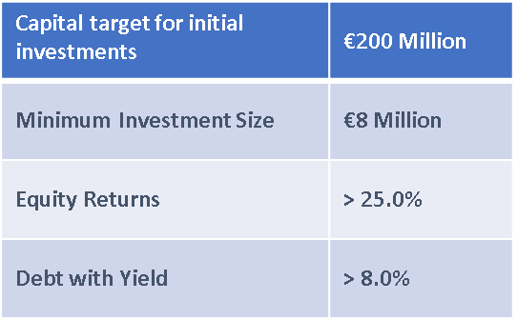
Moving forward

