Slide 2
HERITAGE OR DISRUPTION Tommaso M. Chiorino

Slide 3
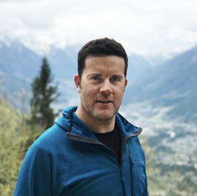
Born in Turin, August 1979, I’m an Italian entrepreneur and investor.
I live in Milan, married to Serena, proud father of Leonardo and Filippo.
I’m the chairman of Gens (family office), Ceo of DCG ( AI on behaviourhal knowledge), Ceo of Later (Real Estate)
I sit in the board of different companies, trying to help them in the difficult path among the digital transformation.

Slide 5
This is ITALY

Slide 6
Also this is ITALY

Slide 7
And this is ITALY too

Slide 8
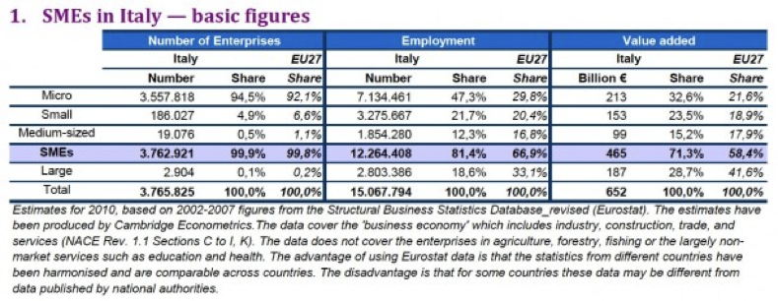
70% of the Italian GDP is made by FAMILY BUSINESS…

Slide 9
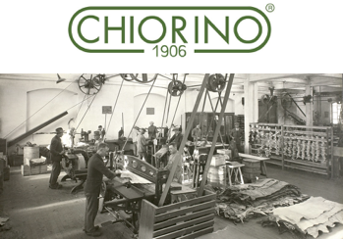
…like this one
As a representative of the fourth generation of entrepreneurs of the world leader in the field of conveyor belts, I had to face a very complex choice (as future reference shareholder): entering the family business or doing something else?
The decision to sell was not simple or quick. This, however, has meant that the family business could grow and that Tommaso could focus on something that felt even stronger: create different realities closer to his time and make them grow without the help of previous generations.

Slide 10
Companies, families, with a KEYWORD
HERITAGE : VALUES
I kept the strong sense for innovation and R&D, keys to the success of the inherited business.
No debts, clear vision, work strong.
That’s why I found GENS, the brand new Chiorino’s holding company and family office

Slide 11
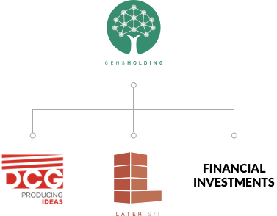
I choose to rebuild a real family company after the split from the original group, no longer a company linked to a product, but a family office with the freedom to invest in different realities.
Hence the desire to leave to my children a legacy made of more diversified assets.
Thus Gens was born (from the Latin “generations”).
From Gens, investments will be in addition to financial operations, real estate through Later and other vehicles, and in digital consultancy and platforms through DCG

Slide 12
MY VALUE : DISRUPTION
For me it means being able to innovate strong but obsolete business, understanding the qualities of the structures and amplifying them thanks to the models of our times.
Marry the old with the new, SME with the start-up.
Working on weaknesses is the only way to discover the real strengths.

Slide 13
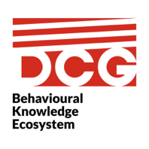
The investment in DCG was made with a particular focus, a middle ground between Venture Capital and the most classic business management, basing its long-term strategy on three pillars that are difficult to intercept in small innovative companies:
- Uniqueness of technological assets
- Internationalization
- Personal Relations

Slide 14
DCG - Behavioural Knowledge Ecosystem
Is a SAAS platform, it has been designed to work as core of a modular ecosystem that will connect the environment data sources identified as useful to the process.
The information acquired will then be filtered, organised and crunched to obtain comprehensive representations of people’s behaviours, allowing us to understand what really happens and predict future actions through the application of proprietary algorithms.
Our solution has been tailored to fit the needs of different industries such as: Retail, Public spaces, Smart city & Transportation, Financial institutions, Entertainment and
Media.

Slide 15
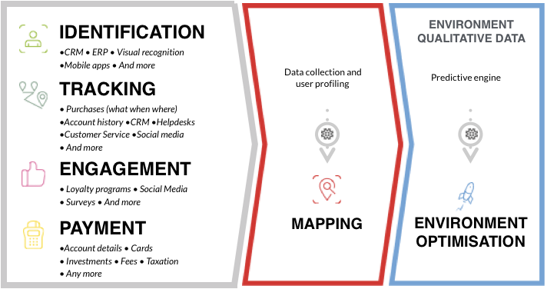
DCG Behavioural Knowledge Ecosystem (BKE)

Slide 19
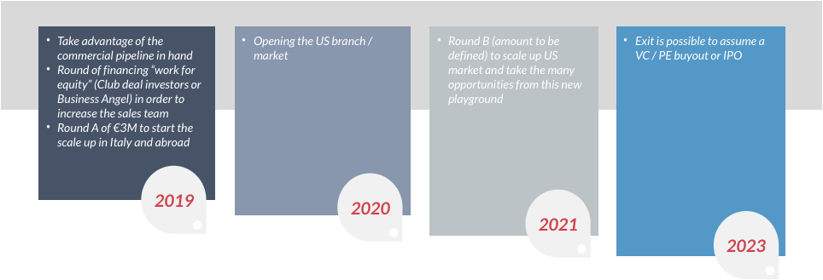
After we invested alone in R&D + launched the business in 3 continents…

Slide 20
That said, what I told you today?
That 2019 would not have existed without 1906
That technology is the driver of change. ALWAYS. Whether you are a small business or a mega corporation.
That alone we born, grow and ... sometimes we die. But that with the help of those who have your own VALUES, you can make a difference.
…So jump on board and ask me about DCG after this speech ;-)

Slide 21
THANK YOU !
t.chiorino@dcg.net

