Slide 1
How do founders & investors work together to build great companies?
Nick Verkroost

Slide 2
$23B
investment into European tech in 2018
Source: Atomico/Dealroom

Slide 3
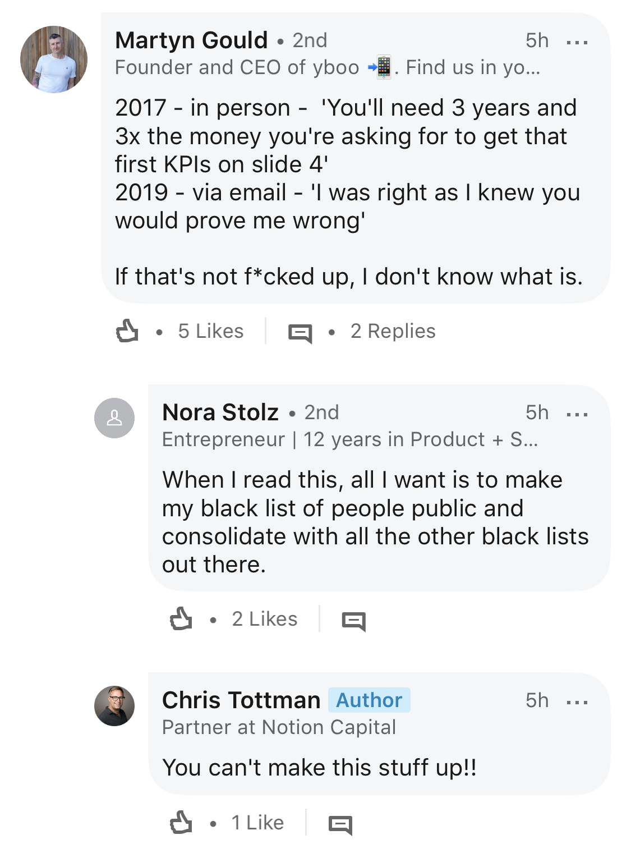

Slide 4
The hard truth:
Once you take someone else’s money, your success is inherently entwined with theirs, and vice versa

Slide 5
A bit about me…

Slide 6
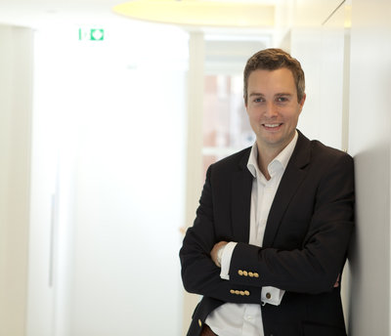
My investor self
Return on investment
Portfolio approach to risk
Accountable to the LPs

Slide 7
My investor self
Return on investment
Portfolio approach to risk
Accountable to the LPs
My entrepreneur self
Change the world
Singular obsession
Accountable to nobody

Slide 8
100:1
to win Series A investment
Source: anecdotally from various VCs

Slide 9
5:2
Series A to Series C
Source: Crunchbase

Slide 10
8%
of UK VCs have ever worked in a startup
Source: Diversity VC

Slide 13
So, what can we do?

Slide 14
“I’d have to be dead or severely incapacitated”

Slide 15
The illusion
The reality
“Founders are playing for batting average”
Fred Destin, Stride.vc

Slide 16
1 out of 34
founders successfully transitioned to CEO unaided
Source: PROfounders

Slide 17
Data protection & privacy
Social & environmental impact
Diversity & inclusion

Slide 18
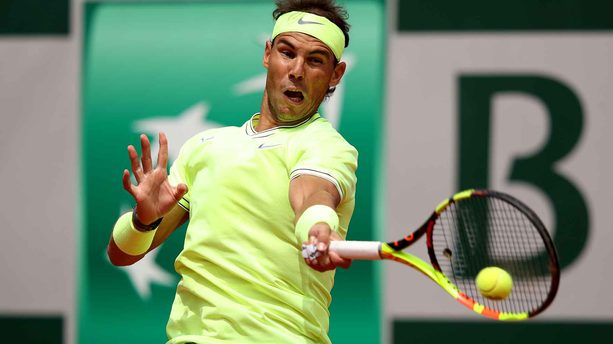

Slide 19
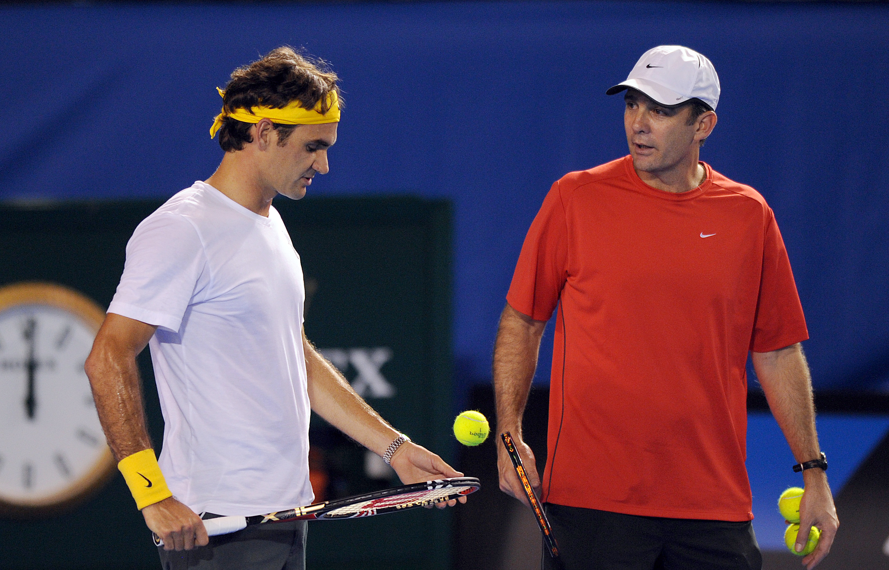
“Coaching … does not at all involve helping them with their skills,
it's more about balancing the emotional and the psychological”
Paul Annacone

Slide 20
Investors
COACH
or get out of the way!
Founders
ATHLETE

Slide 21
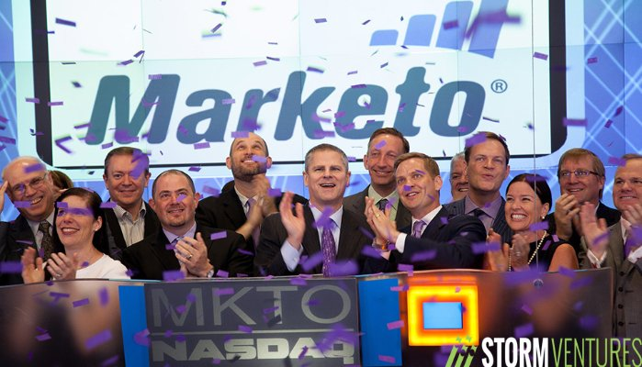

Slide 22
Thank you!

