Slide 2
How technology changes democracy
(and not only)
Luca Emil Abirascid

Slide 3
NEW PARADIGMS/1
NEW PARADIGMS DRIVEN BY NEW TECHNOLOGIES
NEW MODEL FOR ORGANIZATIONS

Slide 4
NEW PARADIGMS/2
PARADIGM SHIFT VS ECONOMIC CRISIS
NEW TECHNOLOGIES ALLOWING NEW MODELS (MOORE LAW SOON OBSOLETE)
DECENTRALIZATION & EXPONENTIAL GROWTH

Slide 5
NEW PARADIGMS/3
OVERCOMING PROFIT / NO PROFIT DICHOTOMY (BENEFIT CORPORATION) NEO NOMADISM
(DISCONNECTION OF TERRITORY-LABOR-LEGISLATIVE FRAMEWORK)

Slide 6
NEW PARADIGMS/4
BLOCKCHAIN CITY STATES (& MICROSTATES) - VS - NATION STATES GLOBAL ENTREPRENEURIAL CULTURE

Slide 7
THE INEFFICIENT SYSTEM/1
REPRESENTATIVE DEMOCRACIES
ARE INEFFICIENT:
POWER CONCENTRATION, CORRUPTION,
MISSPEND, STATUS QUO
NATION STATES ARE LOSING THEIR HISTORICAL ROLE
(es: space economy)

Slide 8
THE INEFFICIENT SYSTEM/2
CENTRALIZED SYSTEMS
ARE LOSING EFFICIENCY:
Es: ENERGY, MANUFACTURING,
INFORMATION, FINANCE (Cryptos), personal info -privacy OPACITY
(ES: FREEDOM OF INFORMATION ACT)

Slide 9
POSSIBLE NEW MODELS
DIRECT DEMOCRACY
HOLACRACY (& OCHLOCRACY)
PANARCHY

Slide 10
SOME EXAMPLES
BITNATION, ETHEREUM, Quadrans TELEPORT - NOMADLIST ESTONIAN E-RESIDENCY
MEDIUM-ZAPPOS-AUTOMATTIC/wp (HOLaCRACY.ORG)
STARTUP ECOSYSTEMS COMPETITION AMONG CITIES, NOT NATIONS

Slide 11
STARTUP/SCALEUPS ECOSYSTEM
NEW IMPRENDITORIAL CULTURE IS GLOBAL AND OVERNATIONAL (ENTREPRENEURS ARE DEVELOPING THEIR VENTURES WHEREVER IS BETTER TO DO IT IN TERMS OF THE MARKET AND ON THE FINANCIAL ENVIRONMENT)

Slide 12
STARTUP/SCALEUPS ECOSYSTEM
NEW GENERATION ENREPRENEURS ARE DRIVING THEIR VENTURES TO CREATe BOTH FINANCIAL/ECONOMIC VALUe AND SOCIAL/ENVIRONMENTAL/CULTURAL IMPACT
SCALEUPS ARE OVERNATIONALS
NOT MULTINATIONALS

Slide 13
STARTUP/SCALEUPS ECOSYSTEM
IN ITALY THE ECOSYSTEM IS STILL LACKING BEHIND IN TERMS OF INVESTMENTS COMPARED TO OTHER EUROPEAN ECONOMIES BUT IN THE LAST 10 YEARS A NEW GENERATIONS OF SCALEUPS CAME UP AND TODAY WE HAVE SMART ENTREPRENEURS DEVELOPING THE ‘MADE IN ITALY 2.0’

Slide 14
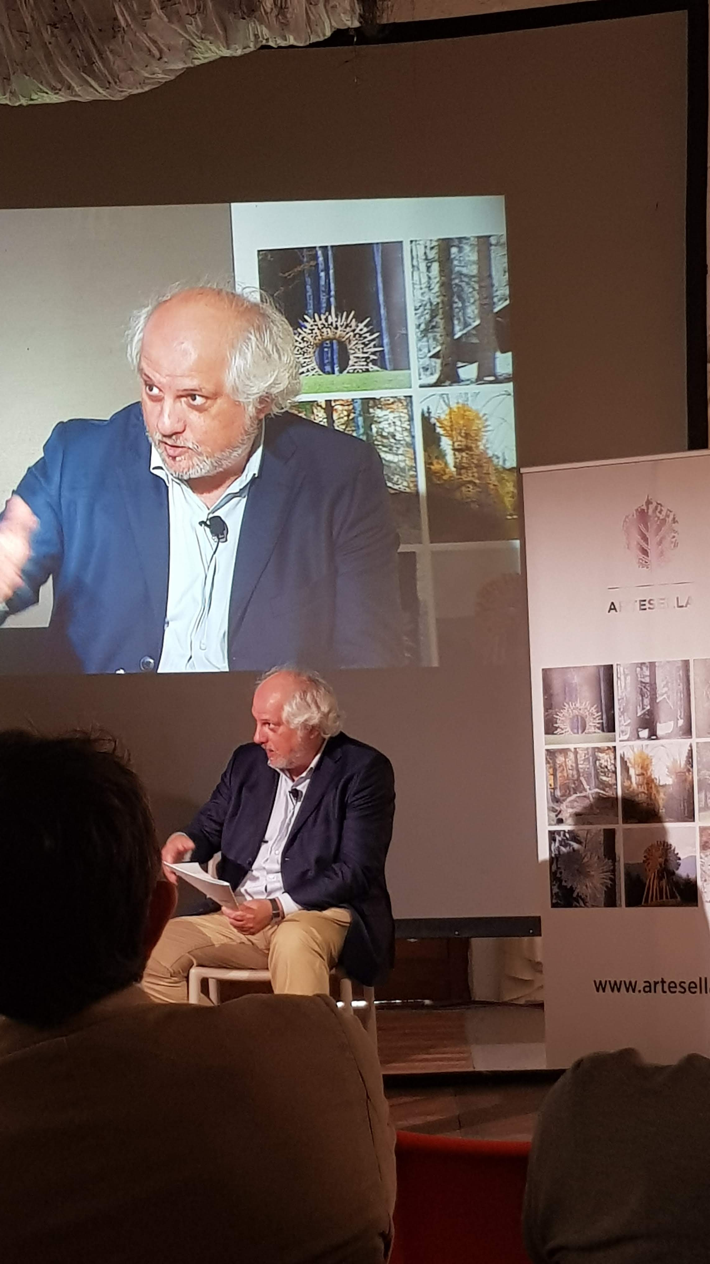
Luca Emil Abirascid www.abirascid.com www.startupbusiness.it twitter: @emilabirascid emil@abirascid.com

